Slide 1
Resolution Sweep
Kumar

Slide 2
Details
Bias voltage sweep from 41 to 44.5 V in steps of 0.1 V
Shaping time sweep from 12.5 to 87.5 ns in steps of 12.5 ns
Runs length of 1 min, run sleep of 15 s
Resolution = µ/σ
µ is the Gaussian Mean of the LED run
Σ is the Gaussian Standard Deviation of the Pedestal Run

Slide 3
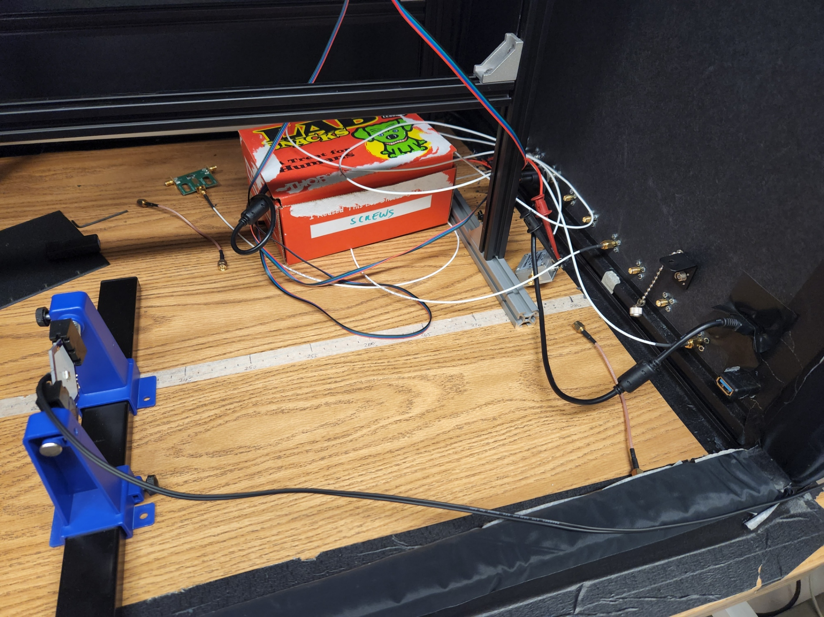
Apparatus
Distance ~ 40 cm
LED Intensity – 8.60
Frequency - Low
SiPm
LED

Slide 4
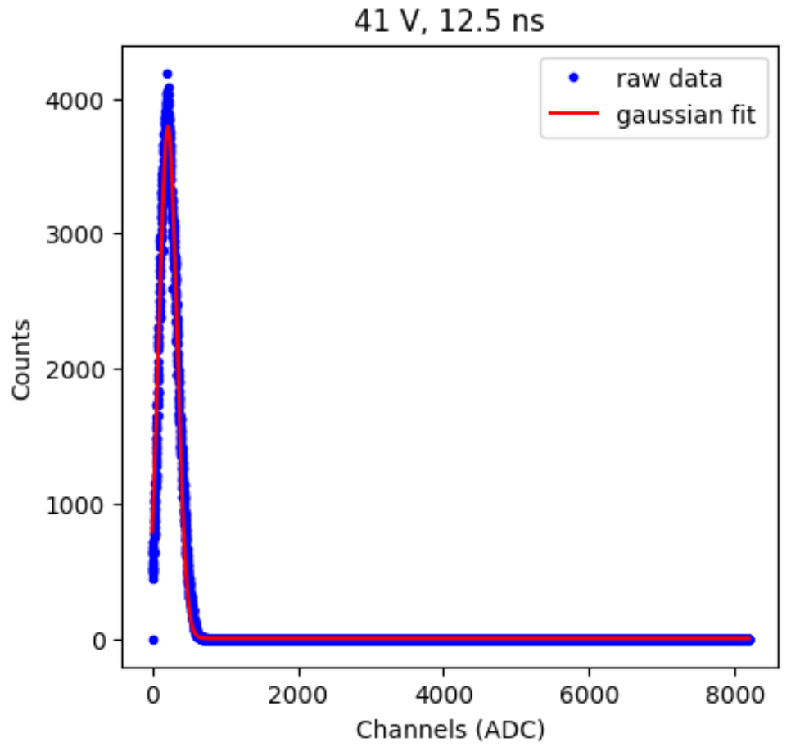
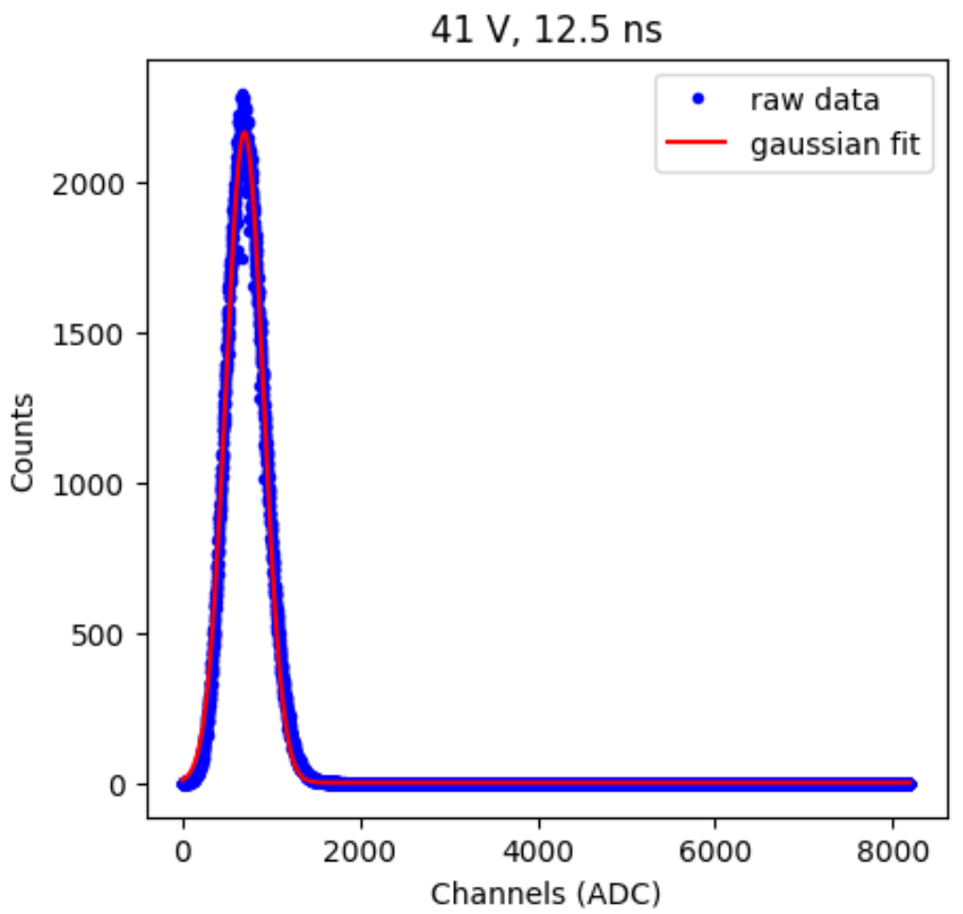
Final sweep up sample
Pedestal
LED

Slide 5
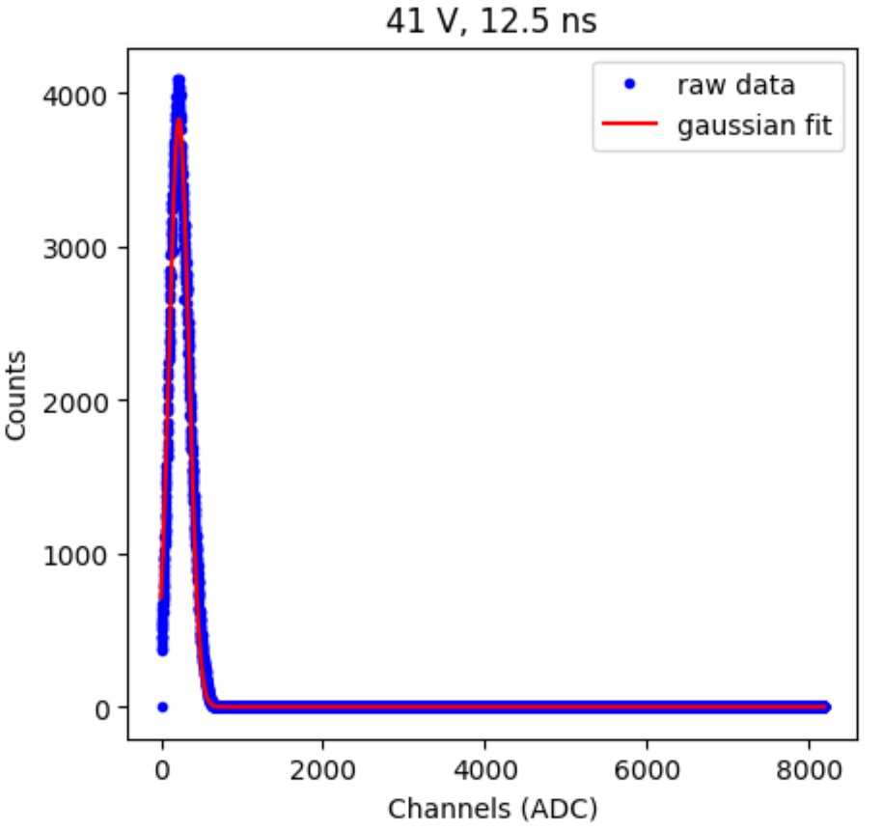
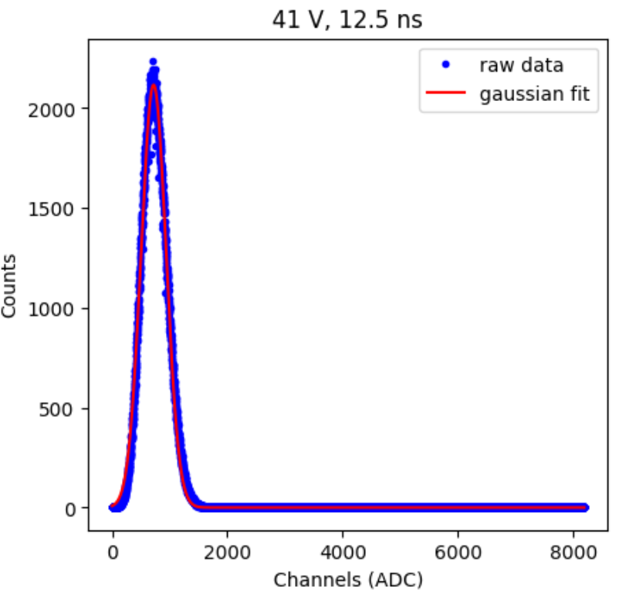
Final sweep down sample
Pedestal
LED

Slide 6
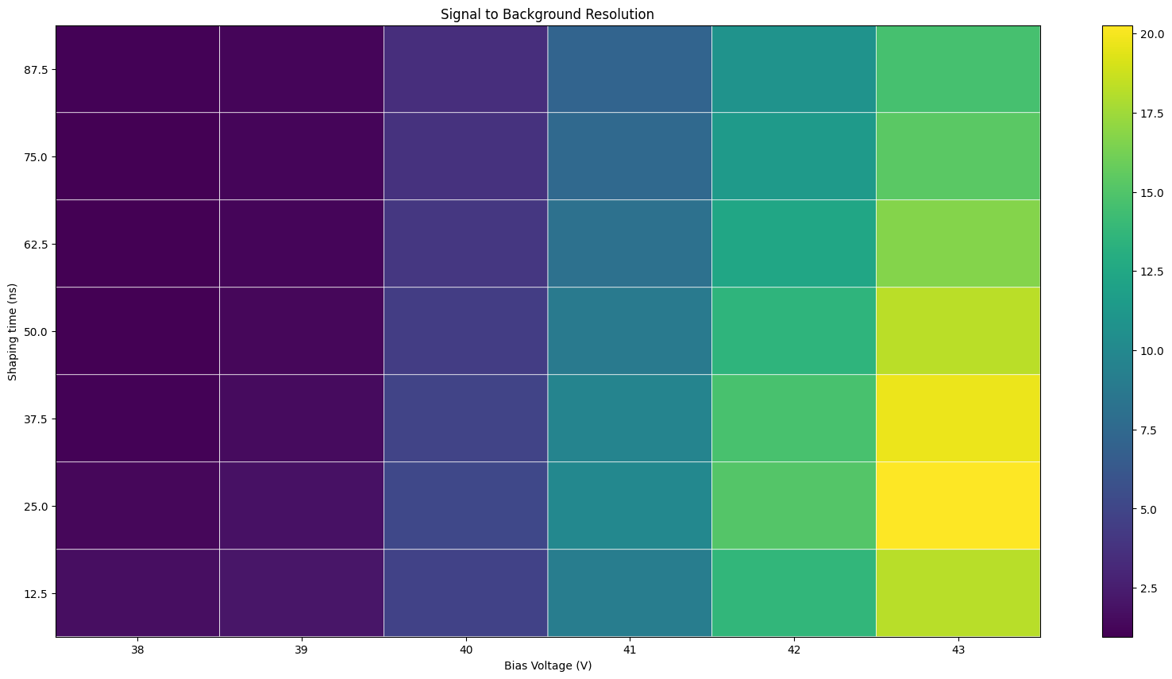
Preliminary sweep up results, Intensity - 10

Slide 7
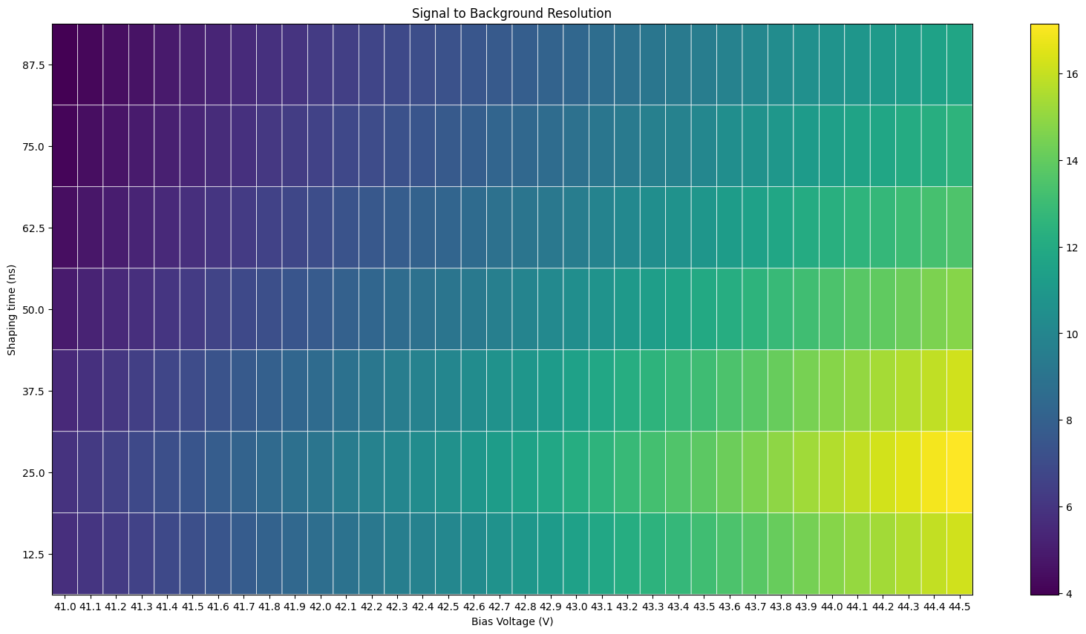
Sweep up Results

Slide 8

Sweep down Results

Slide 9
Potential problems
Issues with the Janus Software saving last run information files
Need to repeat the runs
Appropriate fit functions for data, especially for pedestal runs
Resolution is also sensitive to intensity of the LED, may need to investigate further

Slide 10
Update September 9

Slide 11
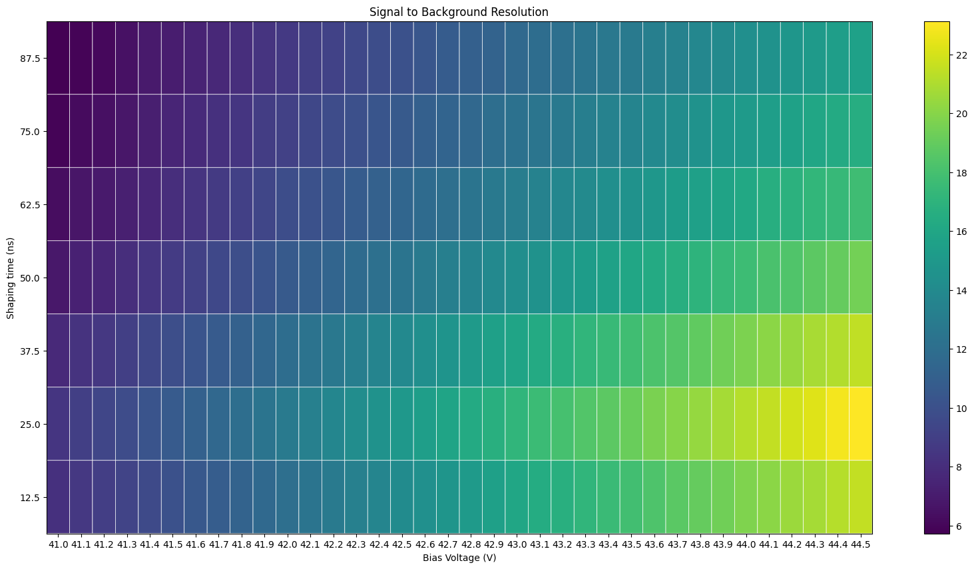
Sweep Up Results

Slide 12

Sweep Down

Slide 13
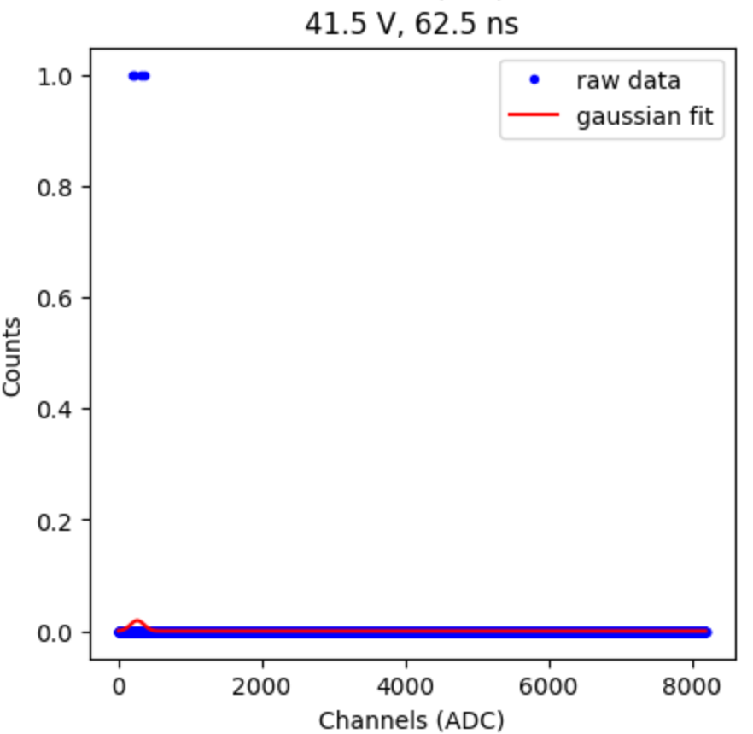
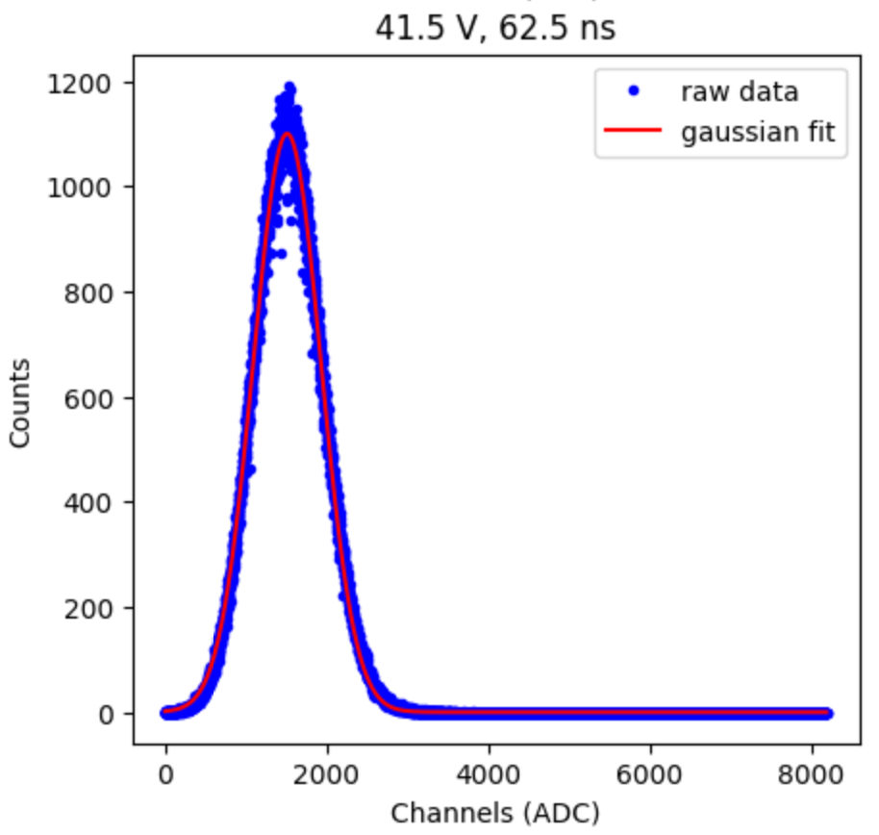
Issue with 41.5 V, 62.5 ns
Pedestal
LED

Slide 14
Issue, speculation
Software issue
Bias voltage may have been shut off, but was turned on again when next config loaded
Hardware issue
Unlikely, but there may have been an issue with the CAEN machine

